Slide 1


LECTURE 1
Mathematical
preliminaries
Foundations of Artificial Intelligence
SEMTM0051 · 2026/27
Lecturer: Dr Roberto Colomboni
Notes:
Suggested time: 0.25 minutes. Running time: 0–0.25 minutes.
The lecture has three parts. We first recall matrix operations, then differential calculus, and finally use derivatives and gradients to find minima.
Visual sources: University of Bristol official logo, https://www.bristol.ac.uk/assets/responsive-web-project/2.7.4/images/logos/uob-logo.svg (downloaded 21 September 2026). Fry Building atrium photograph, WilkinsonEyre, https://wilkinsoneyre.com/projects/university-of-bristol-fry-building ; original image https://wilkinsoneyre.com/images/containers/assets/projects/fry-building/834_n91_16-10-2.jpg/a034f46f36b4bd9bff159b579cfb2daf/834_n91_16-10-2.webp .

Slide 2
Today's lecture
Matrices
Differential calculus
Finding minima using differential calculus
02
Notes:
Suggested time: 0.5 minutes. Running time: 0.25–0.75 minutes.
Introduce the three sections in order. Advance to highlight matrices.

Slide 3
Today's lecture
Matrices
Differential calculus
Finding minima using differential calculus
03
Notes:
Suggested time: 0 minutes. Running time: 0.75–0.75 minutes.
Begin with vectors, shapes and matrix multiplication.

Slide 4
Scalars, vectors and matrices
A matrix is a rectangular array of numbers, arranged in $m$ rows and $n$ columns.
$A_{ij}$ is the scalar entry in row $i$ and column $j$.
Vectors are matrices with exactly one row or one column.
04
Notes:
Suggested time: 0.5 minutes. Running time: 0.75–1.25 minutes.
A real matrix has m rows and n columns, where m and n are arbitrary positive integers. Read its shape as rows by columns. The displayed dots continue the rows and columns to the final indices m and n. A_ij is one scalar entry, selected by row i and column j. A vector is a matrix with exactly one row or exactly one column. Its number d of entries can be any positive integer. Introduce this general notation before moving to the numerical examples on the next slide.
Source: Roberto Colomboni, SEMTM0051_week1_mathematical_preliminaries_final(1).tex, section: Vectors, matrices and index notation.

Slide 5
Adding matrices
Matrices with the same shape can be added:
Add each entry of the first matrix to the entry in the same position of the second
In general, add matching entries:
The sum has the same shape as $A$ and $B$. Subtraction works entry by entry too.
05
Notes:
Start with the definition of matrix addition: the two matrices must have the same shape, and corresponding entries are added. Then reveal the numerical example, including the final matrix, and the comment on subtraction.

Slide 6

Multiplying a matrix by a scalar
Multiplying a matrix by a number means multiplying every entry by that number.
The shape stays the same.
For any scalar $λ$:
The same rules apply to row and column vectors, because they are matrices too.
06
Notes:
Start with the definition of scalar multiplication: multiply each matrix entry by the scalar. Then reveal the numerical example, including the final matrix, and the comment on row and column vectors.

Slide 7
Transposes
Transposing turns each row into a column.
The entries keep their values and change position.
In general, a matrix with shape $m×n$ becomes one with shape $n×m$.
The same operation turns a row vector into a column vector.
07
Notes:
Start with the transpose definition and the change from m by n to n by m. Reveal the matrix example first, then the row-vector example.

Slide 8
Matrix multiplication
Each output entry combines one row of the first matrix with one column of the second. Hence, their lengths must agree.
For entry $C_{ik}$, multiply the paired entries and add their products.
The index $j$ runs through the pairs. The indices $i$ and $k$ identify the output.
08
Notes:
Suggested time: 1 minutes. Running time: 3–4 minutes.
Check shapes before computing. The inner dimensions agree because they count the pairs of entries we multiply. To find the entry at row i and column k, hold i and k fixed, walk along row i of A and down column k of B, then add the products. The summation index j runs through these pairs.
Source: Roberto Colomboni, SEMTM0051_week1_mathematical_preliminaries_final(1).tex, section: Vectors, matrices and index notation.

Slide 9
Matrix multiplication: following the arrows
For each output entry, move along a row of $A$ and down a column of $B$.
Multiply the entries you meet together.
The output position selects the row and column.
The arrows show how to pair their entries.
09
Notes:
Suggested time: 0.25 minutes. Running time: 4–4.25 minutes.
Restore the two-finger diagram from the notes. One finger moves left to right along the selected row of A, while the other moves down the selected column of B. The top-left output uses row one and column one. The other three output positions choose the corresponding row and column. Multiply the entries encountered together, then add. The next slides carry out all four cases with numbers.
Source: Roberto Colomboni, SEMTM0051_week1_mathematical_preliminaries_final(1).tex, section: Vectors, matrices and index notation: matrix multiplication by hand.

Slide 10
Computing $C_{11}$: row 1, column 1
$C_{11}$ uses row 1 of $A$ and column 1 of $B$. The two colours will identify the two pairs of factors.
$$A$$
$$B$$
$$C$$
5
5
6
6
1
1
2
23
×
=
7
8
3
3
4
$$C_{11}=$$
5 × 1
+
6 × 3
= 23
$5+18=23$: the sum fills the selected entry of $C$.
10
Notes:
Suggested time: 0.5 minutes. Running time: 4.25–4.75 minutes.
The outlined cell is C11. On the first click, A11=5 and B11=1 turn teal and their product appears. On the second click, A12=6 and B21=3 turn orange and the second product appears. On the third click, add 5 and 18 to get 23, which fills the selected cell. Previously computed entries remain visible.
Source: Roberto Colomboni, SEMTM0051_week1_mathematical_preliminaries_final(1).tex, section: Vectors, matrices and index notation: matrix multiplication by hand.

Slide 11
Computing $C_{12}$: row 1, column 2
$C_{12}$ uses row 1 of $A$ and column 2 of $B$. The two colours will identify the two pairs of factors.
$$A$$
$$B$$
$$C$$
5
5
6
6
1
2
2
23
34
×
=
7
8
3
4
4
$$C_{12}=$$
5 × 2
+
6 × 4
= 34
$10+24=34$: the sum fills the selected entry of $C$.
11
Notes:
Suggested time: 0.5 minutes. Running time: 4.75–5.25 minutes.
The outlined cell is C12. On the first click, A11=5 and B12=2 turn teal and their product appears. On the second click, A12=6 and B22=4 turn orange and the second product appears. On the third click, add 10 and 24 to get 34, which fills the selected cell. Previously computed entries remain visible.
Source: Roberto Colomboni, SEMTM0051_week1_mathematical_preliminaries_final(1).tex, section: Vectors, matrices and index notation: matrix multiplication by hand.

Slide 12
Computing $C_{21}$: row 2, column 1
$C_{21}$ uses row 2 of $A$ and column 1 of $B$. The two colours will identify the two pairs of factors.
$$A$$
$$B$$
$$C$$
5
6
1
1
2
23
34
×
=
7
7
8
8
3
3
4
31
$$C_{21}=$$
7 × 1
+
8 × 3
= 31
$7+24=31$: the sum fills the selected entry of $C$.
12
Notes:
Suggested time: 0.5 minutes. Running time: 5.25–5.75 minutes.
The outlined cell is C21. On the first click, A21=7 and B11=1 turn teal and their product appears. On the second click, A22=8 and B21=3 turn orange and the second product appears. On the third click, add 7 and 24 to get 31, which fills the selected cell. Previously computed entries remain visible.
Source: Roberto Colomboni, SEMTM0051_week1_mathematical_preliminaries_final(1).tex, section: Vectors, matrices and index notation: matrix multiplication by hand.

Slide 13
Computing $C_{22}$: row 2, column 2
$C_{22}$ uses row 2 of $A$ and column 2 of $B$. The two colours will identify the two pairs of factors.
$$A$$
$$B$$
$$C$$
5
6
1
2
2
23
34
×
=
7
7
8
8
3
4
4
31
46
$$C_{22}=$$
7 × 2
+
8 × 4
= 46
$14+32=46$: the sum fills the selected entry of $C$.
13
Notes:
Suggested time: 0.5 minutes. Running time: 5.75–6.25 minutes.
The outlined cell is C22. On the first click, A21=7 and B12=2 turn teal and their product appears. On the second click, A22=8 and B22=4 turn orange and the second product appears. On the third click, add 14 and 32 to get 46, which fills the selected cell. Leave the complete calculation visible. Advance to the next slide to discuss reversing the order of multiplication.
Source: Roberto Colomboni, SEMTM0051_week1_mathematical_preliminaries_final(1).tex, section: Vectors, matrices and index notation: matrix multiplication by hand.

Slide 14
Matrix multiplication is not commutative
Reversing the order of the factors can change whether the product is defined, and it can change its value.
$$A$$
$$B$$
$$C$$
5
6
1
2
23
34
×
=
7
8
3
4
31
46
Warning: $AB$ can be defined even when $BA$ is not.
Even when both have the same shape, in general $AB≠BA$.
Exercise: compute $BA$ for the matrices above and compare it with $AB$.
14
Notes:
Suggested time: 0.25 minutes. Running time: 6.25–6.5 minutes.
Both matrices and their product are shown without coloured factor highlights or a selected output cell. AB being defined does not imply BA is defined. Even when both products have matching shapes, they need not be equal. Ask students to compute BA as an exercise. For these matrices, BA has rows (19,22) and (43,50), while AB has rows (23,34) and (31,46).
Source: Roberto Colomboni, SEMTM0051_week1_mathematical_preliminaries_final(1).tex, section: Vectors, matrices and index notation: matrix multiplication.

Slide 15
Properties of matrix multiplication
For compatible dimensions, changing the brackets does not change the product.
Matrix multiplication is associative.
If you have never checked this, prove it as an exercise!
Transposing a product reverses the order of its factors.
15
Notes:
Suggested time: 1.25 minutes. Running time: 6.5–7.75 minutes.
Associativity changes the grouping of three compatible factors, without changing their order. If students have never proved it, ask them to expand an entry on each side as a double sum. A transpose exchanges the output row and column. In the transpose of a product the two factors therefore appear in reverse order. Both results apply to rectangular matrices of compatible shapes.
Source: Roberto Colomboni, SEMTM0051_week1_mathematical_preliminaries_final(1).tex, section: Matrices: products, norms, identity matrices, inverses and linear systems.

Slide 16
The Euclidean norm
The Euclidean norm is the square root of the sum of the squared entries.
Its square can also be written as a matrix product.
For a column vector $c∈ℝ^{d×1}$:
For a row vector $r∈ℝ^{1×d}$:
Both products have shape $1×1$, which we identify with a scalar.
16
Notes:
Suggested time: 1 minutes. Running time: 7.75–8.75 minutes.
The Euclidean norm is the nonnegative square root of the sum of the squared entries. The two displayed products give the squared norm. For a column, transpose the first factor. For a row, transpose the second. Check shapes: one by d times d by one gives one by one, which we identify with a scalar. For the column (2,-1), the squared norm is 5 and the norm is the square root of 5.
Source: Roberto Colomboni, SEMTM0051_week1_mathematical_preliminaries_final(1).tex, section: Matrices: products, norms, identity matrices, inverses and linear systems.

Slide 17
The identity matrix
The identity matrix $I_{n}$ is the $n×n$ matrix with ones on the diagonal and zeros everywhere else.
Multiplication leaves $A∈ℝ^{m×n}$ unchanged when the dimensions match:
If you have never checked this, prove it as an exercise!
17
Notes:
Suggested time: 1 minutes. Running time: 8.75–9.75 minutes.
The identity matrix is square in any dimension. Its diagonal entries are one, and all other entries are zero. Point along the diagonal and then to the off-diagonal entries. For a rectangular matrix A with m rows and n columns, the left identity is m by m and the right identity is n by n. Ask students to check both equalities directly from the definition of multiplication.
Source: Roberto Colomboni, SEMTM0051_week1_mathematical_preliminaries_final(1).tex, section: Matrices: products, norms, identity matrices, inverses and linear systems.

Slide 18

Invertible matrices
A square matrix $A∈ℝ^{n×n}$ is invertible if there exists a matrix $B∈ℝ^{n×n}$ s.t.
One can prove that this matrix $B$ is unique.
We call it the inverse of $A$ and denote it by $A^{−1}$.
Thus
A square matrix with no inverse is called singular.
18
Notes:
Suggested time: 1.25 minutes. Running time: 9.75–11 minutes.
Start with a square matrix A. Invertibility means that another square matrix B of the same size multiplies with A to give the identity in either order. This is a definition, not a formula for finding B. The matrix B is unique: if B and C both work, B = BI = B(AC) = (BA)C = IC = C. Because of this uniqueness we use the name inverse and the notation A to the power minus one. A square matrix with no inverse is called singular.
Source: Roberto Colomboni, SEMTM0051_week1_mathematical_preliminaries_final(1).tex, section: Matrices: products, norms, identity matrices, inverses and linear systems.

Slide 19
An inverse in two dimensions
For a $2×2$ matrix, the inverse exists exactly when $ad−bc≠0$. In that case,
For example, here $ad−bc=4−6=−2$:
Check that $AA^{−1}=I_{2}=A^{−1}A$.
19
Notes:
Suggested time: 1.5 minutes. Running time: 11–12.5 minutes.
For a two by two matrix the inverse exists exactly when ad minus bc is nonzero. Read the formula: divide by ad minus bc, exchange the diagonal entries and negate the off-diagonal entries. Apply this to the matrix with rows (1,2) and (3,4). The denominator is minus two, so the inverse has rows (-2,1) and (3/2,-1/2). Ask students to verify both products with the original matrix.
Source: Roberto Colomboni, SEMTM0051_week1_mathematical_preliminaries_final(1).tex, section: Matrices: products, norms, identity matrices, inverses and linear systems.

Slide 20
Solving a linear system with an inverse
Let $A∈ℝ^{n×n}$ be invertible and $b∈ℝ^{n×1}$.
We want to solve the linear system $Ax=b$ for a column vector $x$.
Any solution must satisfy:
This candidate also satisfies the equation:
Therefore the solution exists and is unique: $x=A^{−1}b$.
20
Notes:
Suggested time: 1.5 minutes. Running time: 12.5–14 minutes.
A is an invertible n by n matrix and b is an n by one column. We seek a column x satisfying Ax=b. Any solution must obey the displayed chain: the identity leaves x unchanged, the inverse identity replaces I, associativity changes the grouping, and Ax is replaced by b. Reveal each equality in turn. This shows that any solution must be A inverse b. Finally substitute that candidate into the equation to prove it is a solution. The two observations give existence and uniqueness.
Source: Roberto Colomboni, SEMTM0051_week1_mathematical_preliminaries_final(1).tex, section: Matrices: products, norms, identity matrices, inverses and linear systems.

Slide 21
Indicator functions and the Kronecker delta
An indicator turns a condition into a number:
one when the condition holds, and zero otherwise.
The Kronecker delta is the indicator that two indices agree:
In a sum, it keeps only the term with the matching index:
21
Notes:
Suggested time: 1 minutes. Running time: 14–15 minutes.
An indicator converts a true-or-false condition into a number: one when the condition holds and zero otherwise. A denotes any condition. For example, the indicator of 2 less than 3 is one, while the indicator of 2 equal to 3 is zero. The Kronecker delta is the particular indicator of the condition i equals j. These are exactly the entries of the identity matrix. In the expanded sum, every coefficient is zero except delta_ii=1, so only a_i survives. The ellipses cover the terms before and after i. At i=1 or i=d, omit the empty block. Reveal the Kronecker delta first, then the general expanded sum.
Source: Roberto Colomboni, SEMTM0051_week1_mathematical_preliminaries_final(1).tex, section: Indicator functions and the Kronecker delta.

Slide 22
Today's lecture
Matrices
Differential calculus
Finding minima using differential calculus
22
Notes:
Suggested time: 0.25 minutes. Running time: 15–15.25 minutes.
We now study how function values change, first in one variable and then in several variables.

Slide 23
Functions and function values
A function assigns exactly one output to each input in its domain. The graph shows how inputs and outputs are paired.
At input $x=3$, the output is
The highlighted point is $(3,9)$.
The graph consists of the points $(x,f(x))$.
23
Notes:
Suggested time: 0.5 minutes. Running time: 15.25–15.75 minutes.
A function assigns exactly one output to each input in its domain. This example has real inputs and real outputs, with the rule f(x)=x squared. The graph collects the pairs (x,f(x)). Read the input on the horizontal axis and the output on the vertical axis. At input 3, move vertically to the curve, then horizontally to read output 9. The orange point is (3,9). The negative input -3 has the same output, which is allowed: the requirement is one output for each input, not a different output for every different input.
Source: Roberto Colomboni, SEMTM0051_week1_mathematical_preliminaries_final(1).tex, section: Functions and function values.

Slide 24
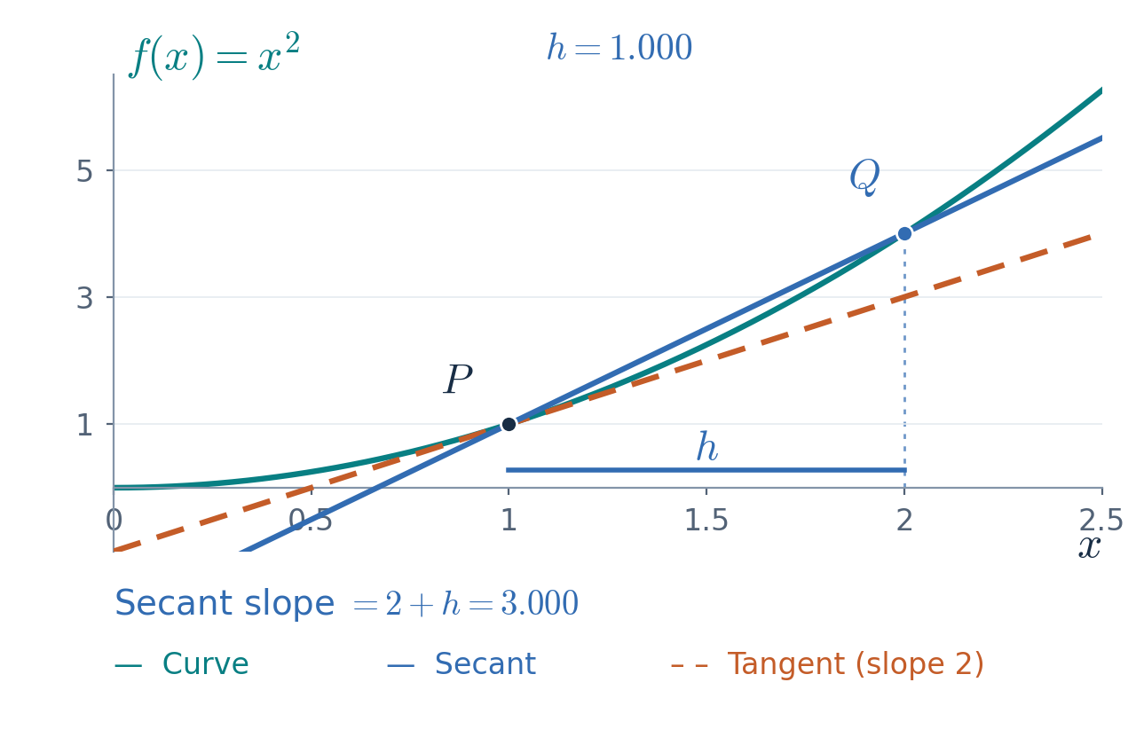



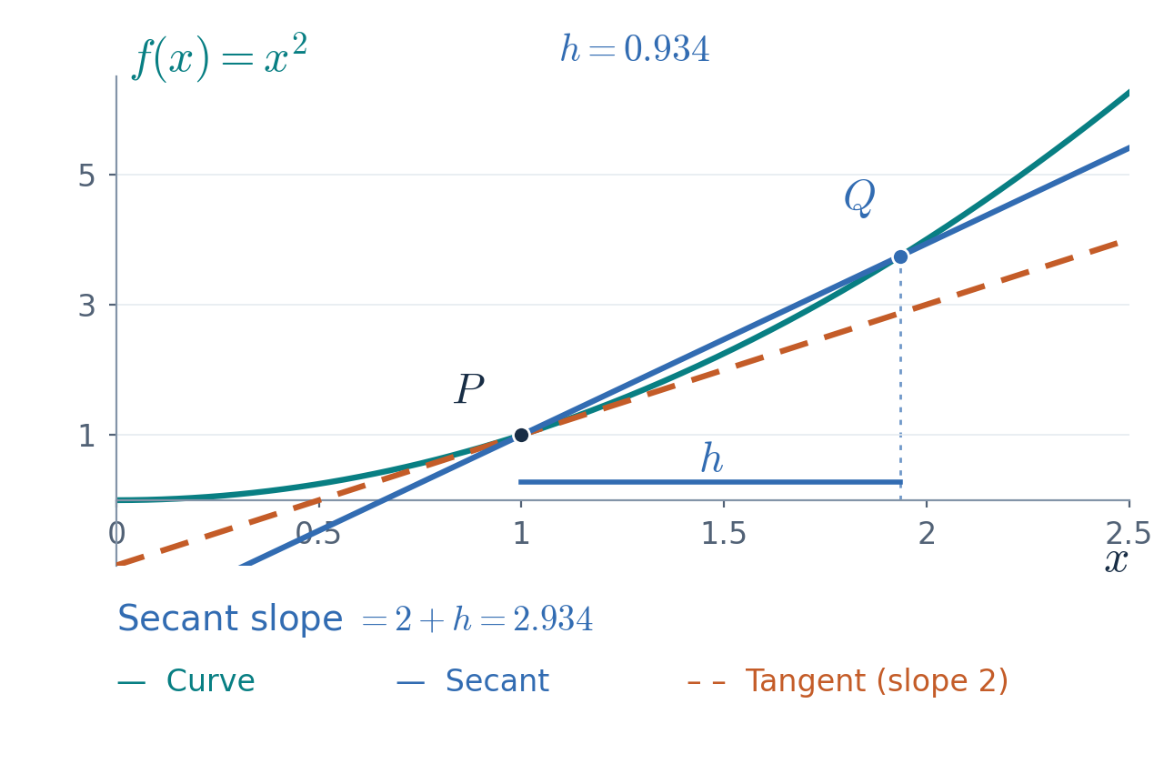


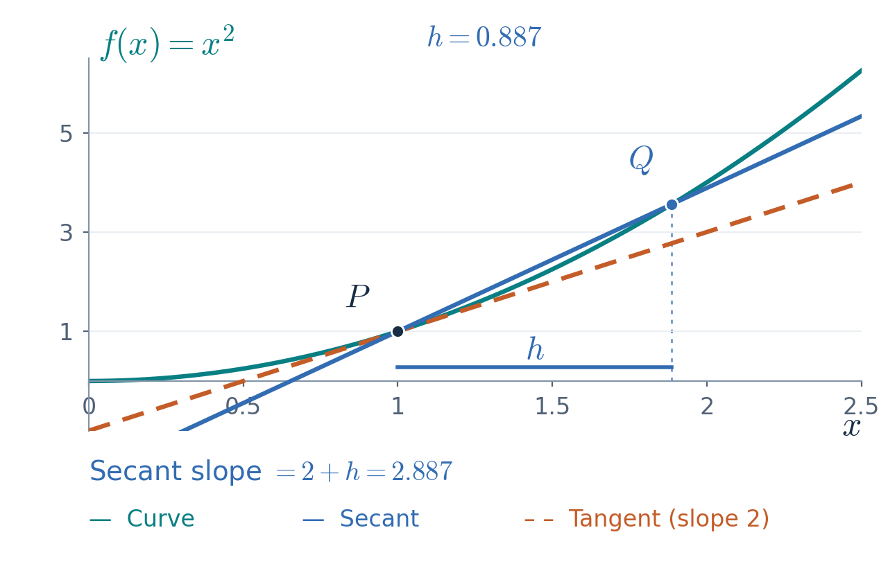
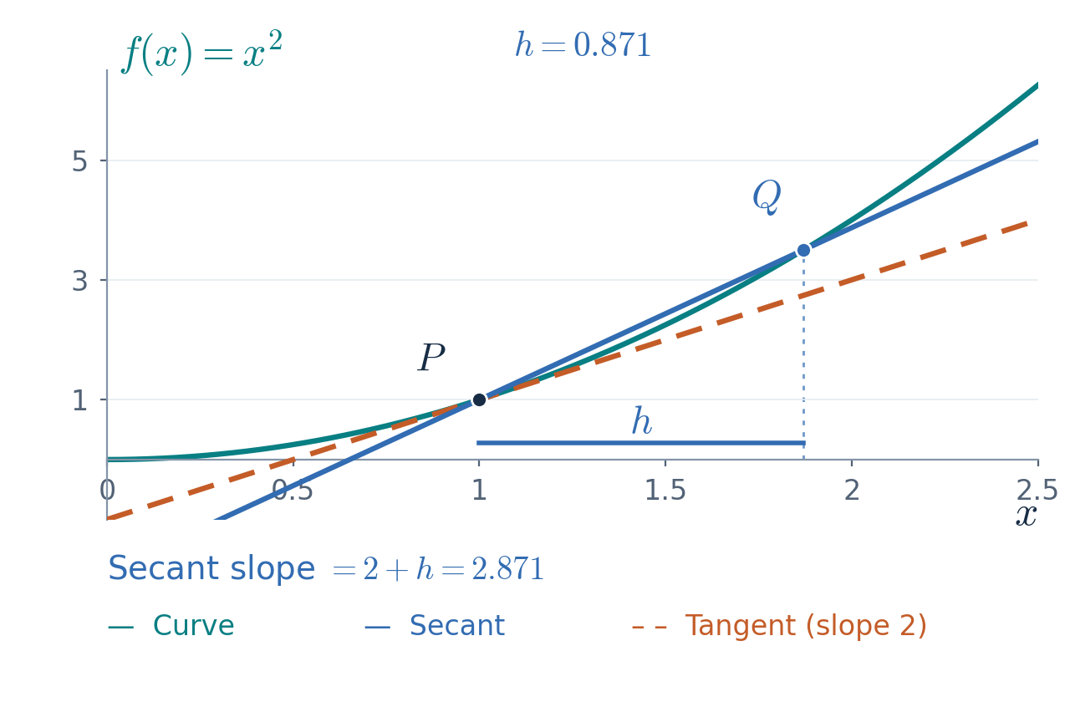



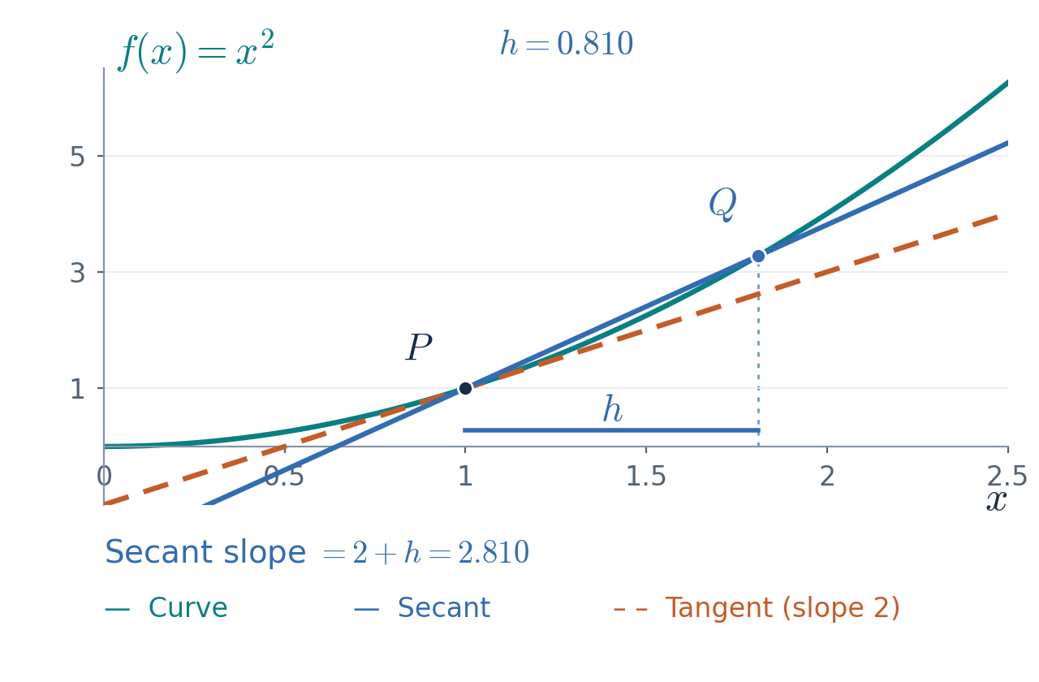








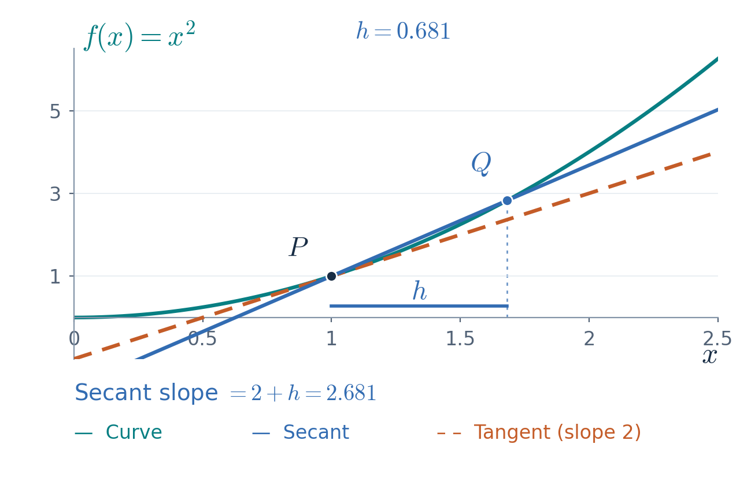






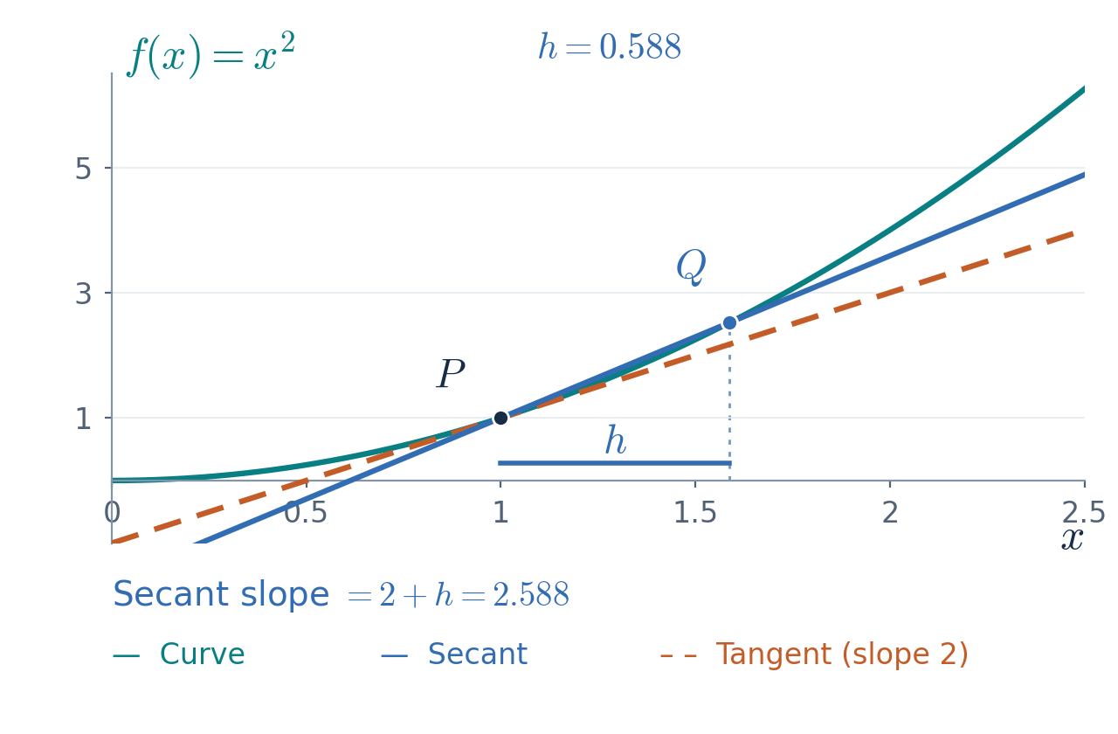



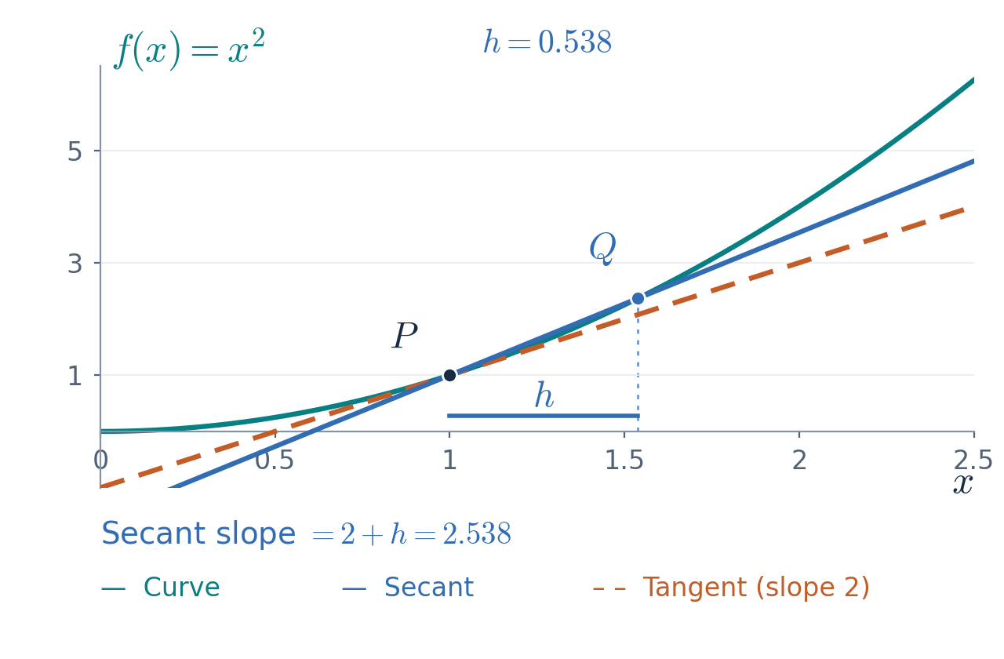



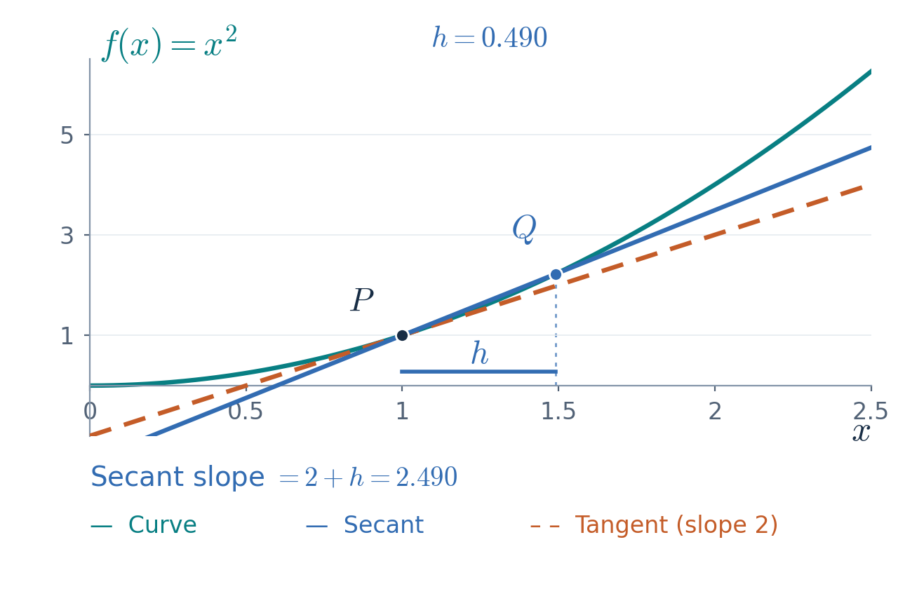



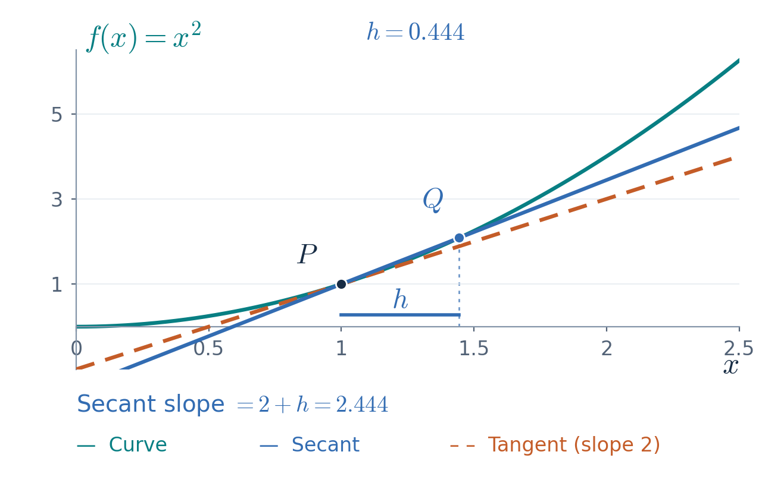

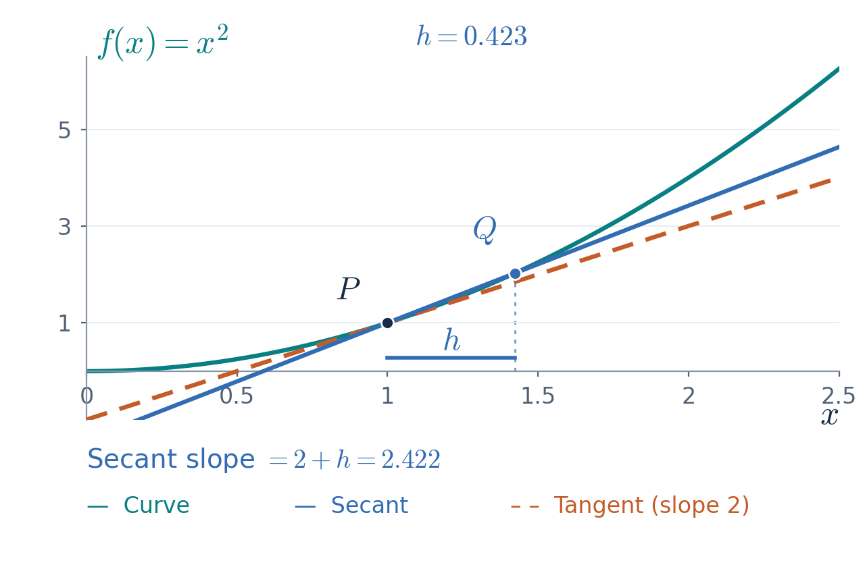










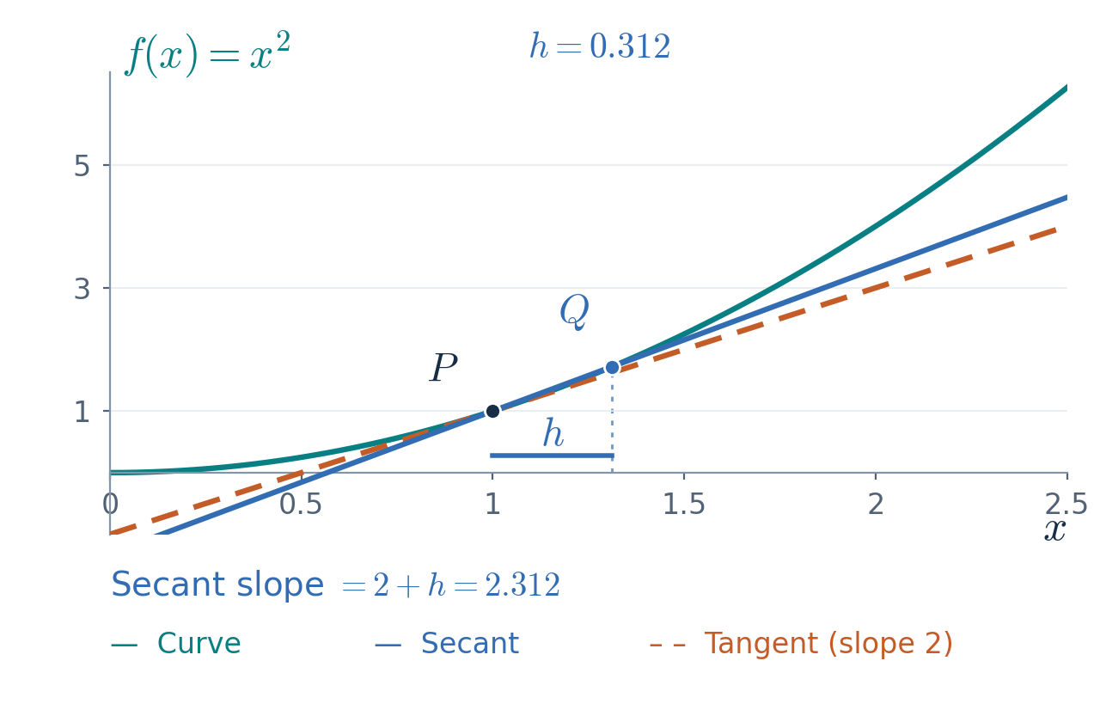


























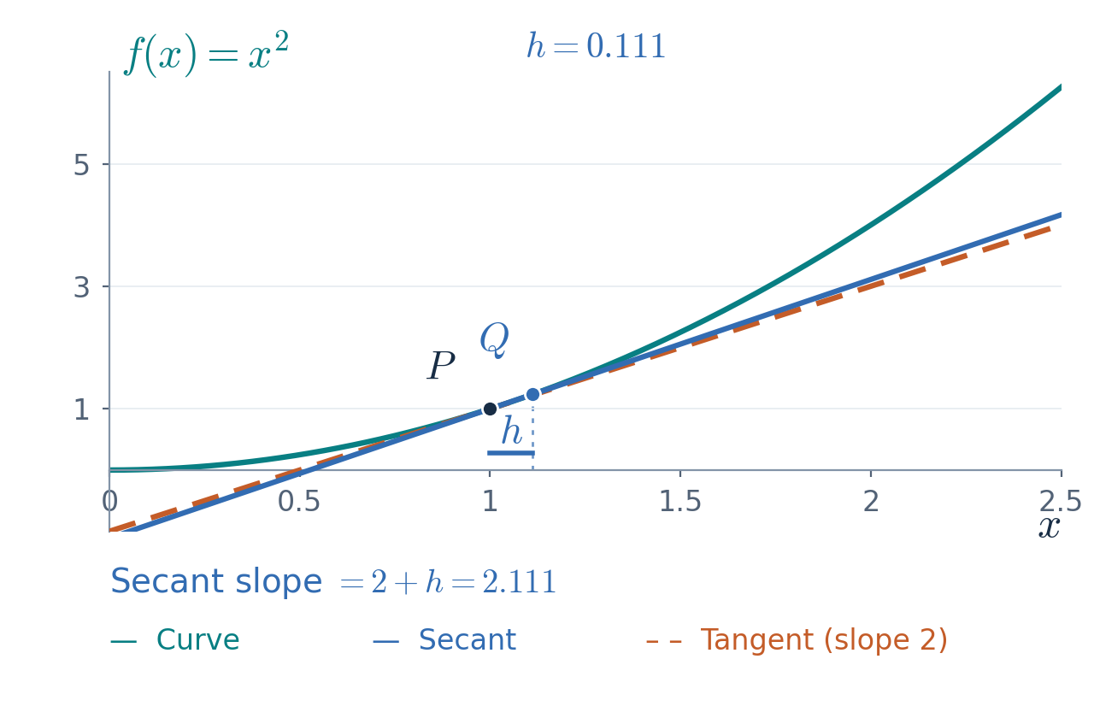


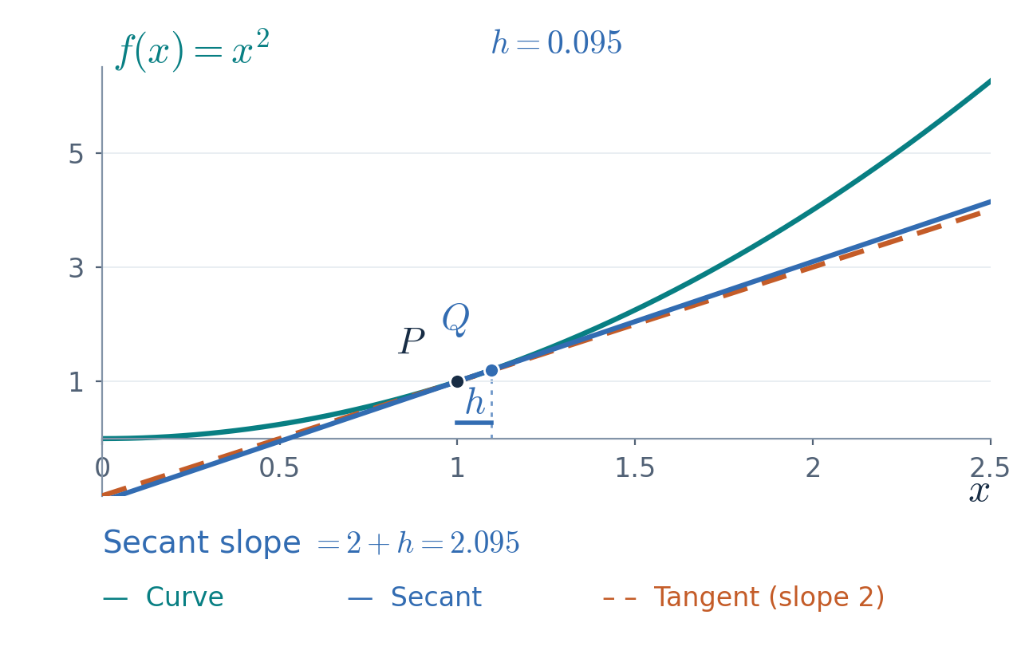

























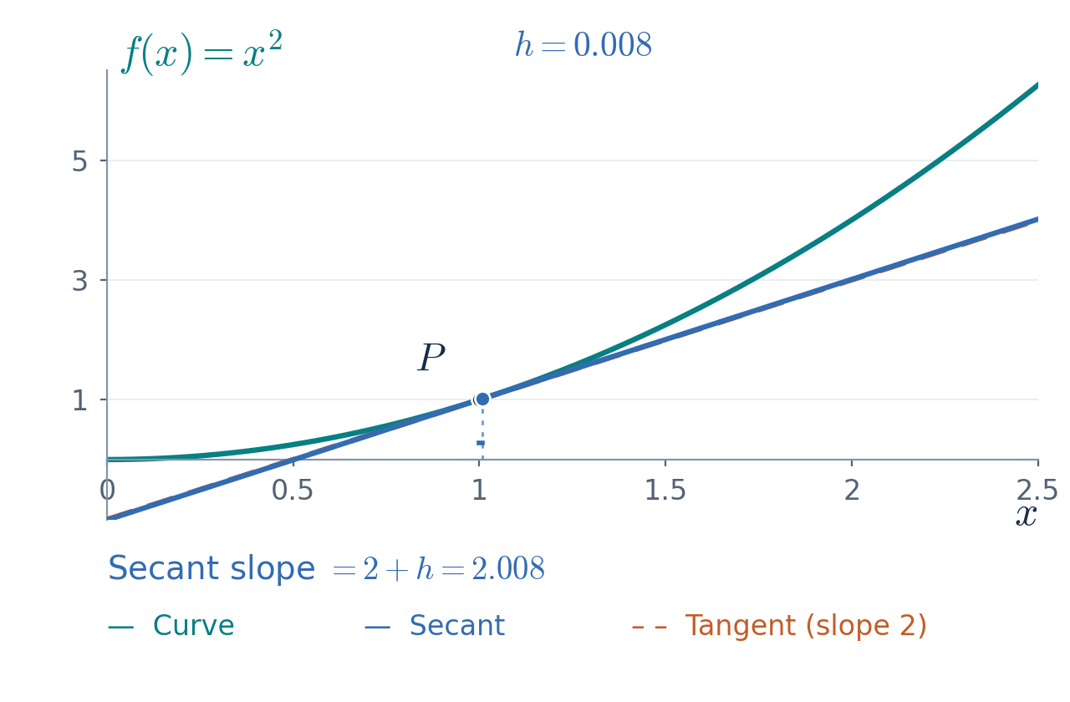











A derivative measures change
A derivative is the limiting slope as the two points of a secant come together.
The secant uses two points.
As the points come together,
it approaches the tangent.
The derivative exists when this limit is a finite real number.
24
Notes:
Suggested time: 2 minutes. Running time: 15.75–17.75 minutes.
Begin with the graph f(x)=x squared and ask how steep it is at x=1. In PowerPoint Slide Show, click once or press the next arrow to start the 11-second sequence. The animation uses 121 ordinary Appear effects on embedded scientific plot frames. It does not use a movie or media playback. The fixed point P is (1,1). The point Q=(1+h,(1+h)^2) approaches P as h decreases from 1 towards zero. For h>0 the secant slope is ((1+h)^2-1)/h=2+h, which tends to 2. The final frame uses limit notation, rather than evaluating a quotient at h=0. When the motion finishes, the next click reveals the limit definition and the following click reveals f prime(1)=2. The PDF shows the final frame. Implementation reference: Microsoft Open XML CommonTimeNode and SetBehavior documentation, https://learn.microsoft.com/en-us/dotnet/api/documentformat.openxml.presentation.commontimenode and https://learn.microsoft.com/en-us/dotnet/api/documentformat.openxml.presentation.setbehavior .
Source: Roberto Colomboni, SEMTM0051_week1_mathematical_preliminaries_final(1).tex, section: Derivatives and gradients.

Slide 25
Standard derivatives
Constants, powers, exponentials and logarithms give the basic rules.
If $p∈ℤ$, the power rule also holds for $x≠0$.
25
Notes:
Suggested time: 3 minutes. Running time: 17.75–20.75 minutes.
Recall four basic derivative rules: constants, powers, the natural exponential and the natural logarithm. The constant and the exponent do not depend on x. Treat constants separately, and state the power rule for nonzero real p and positive x. If p is an integer, the same formula also holds for every nonzero x. The cases x, reciprocal x and square root of x are covered by the power rule and do not need separate displayed rules. They can be mentioned orally using p=1, p=-1 and p=1/2. For positive integer p the derivative at x=0 is also defined, but the displayed nonzero-input condition is a sufficient common domain for all integer exponents. Log denotes the natural logarithm. Reveal the power rule with its domain note, then the exponential, then the logarithm.
Source: Roberto Colomboni, SEMTM0051_week1_mathematical_preliminaries_final(1).tex, section: Derivatives and gradients.

Slide 26
Linearity and the product rule
For constants $a$ and $b$, differentiate each term and keep its coefficient.
For a product, differentiate each factor in turn and keep the other fixed.
26
Notes:
Suggested time: 3 minutes. Running time: 20.75–23.75 minutes.
First differentiate a linear combination. The coefficients a and b are constants with respect to x, so each remains in place. The example retains the three powers used earlier, including the negative half power. Reveal its derivative after asking for the three contributions. Then turn to a product: either factor can change, so the derivative adds the two contributions. In each contribution the other factor stays unchanged. The short product example can also be checked by first expanding x squared times x plus one. These two rules will be used inside the chain-rule exercises.
Source: Roberto Colomboni, SEMTM0051_week1_mathematical_preliminaries_final(1).tex, section: Derivatives and gradients.

Slide 27
The chain rule: two notations
Let $F\left(s\right)=v\left(u\left(s\right)\right)$, i.e. $F$ is the composition of $v$ and $u$, $F=v∘u$
Prime notation
Leibniz notation
Abbreviated form
(abuse of notation)
Here $dv/du$ is evaluated at $u=u(s)$,
while $dv/ds$ denotes the derivative of the composition $F$.
27
Notes:
Suggested time: 2 minutes. Running time: 23.75–25.75 minutes.
Define F(s)=v(u(s)). In prime notation, differentiate the outer function at the actual intermediate value u(s), and multiply by the inner derivative at s. Introduce Leibniz notation precisely first: dF/ds evaluated at s equals dv/du evaluated at u=u(s), times du/ds evaluated at s. Only on the next click introduce the common abbreviation dv/ds=(dv/du)(du/ds). This is an abuse of notation: the evaluation of dv/du at u(s) is implicit, and dv/ds denotes the derivative of the composition F, not the derivative of the outer function with respect to its own argument. The notation suggests cancellation, but cancellation is only a mnemonic, not a proof.
Source: Roberto Colomboni, SEMTM0051_week1_mathematical_preliminaries_final(1).tex, section: Derivatives and gradients: the chain rule.

Slide 28
A complete chain-rule example
Differentiate the inner and outer functions, then substitute and multiply.
Exercise: differentiate $H(s)=log(1+e^{s})$ using both notations.
28
Notes:
Suggested time: 3.25 minutes. Running time: 25.75–29 minutes.
Take F(s)=(2s+5) cubed. Set u(s)=2s+5 and v(u)=u cubed. Differentiate these functions independently, then substitute the inner value into the outer derivative and multiply by the inner derivative. Show both prime and Leibniz notation, with the substitution explicit. In the precise Leibniz formula, dF/ds is evaluated at s, the outer derivative dv/du is evaluated at u=2s+5, and the inner derivative du/ds is evaluated at s. The abbreviation dv/ds was introduced on the preceding slide as an abuse of notation. Each line appears on a separate click and remains visible. Finally reveal an exercise: differentiate H(s)=log(1+exp(s)) in both notations. For the exercise use u(s)=1+exp(s), v(u)=log(u), u prime=exp(s), and v prime=1/u. The answer is H prime(s)=exp(s)/(1+exp(s)); the logarithm is defined for every real s because 1+exp(s)>0.
Source: Roberto Colomboni, SEMTM0051_week1_mathematical_preliminaries_final(1).tex, section: Derivatives and gradients.

Slide 29
Partial derivatives: one variable at a time
Fix all inputs except one, then take an ordinary derivative.
The resulting partial derivative can still depend on every input.
Each partial derivative exists when its limit is a finite real number.
Example:
Vary $a$ and keep $b$ fixed.
Vary $b$ and keep $a$ fixed.
29
Notes:
First state the two limit definitions of partial derivatives, emphasizing that the other coordinate stays fixed. Each limit must exist as a finite real number. Then reveal the polynomial example. Calculate the first partial derivative, evaluate it at (1,2), and repeat for the second coordinate.

Slide 30

Differentiability
A function $Q:ℝ^{d}→ℝ$ is differentiable at $w$
if there exists a column vector $g∈ℝ^{d}$ such that
The error in the linear approximation becomes negligible compared with the size of the input change.
One can prove that this vector is unique and equals the vector of partial derivatives, namely the gradient:
Partial derivatives can exist even when the function is not differentiable.
30
Notes:
Suggested time: 3 minutes. Running time: 33.75–36.75 minutes.
Define differentiability without assuming that partial derivatives already provide the linear approximation. A scalar function Q on R^d is differentiable at w if a column g exists for which the displayed error, divided by the norm of h, tends to zero as h tends to zero. Equivalently, Q(w+h)=Q(w)+g transpose h plus a remainder that is little-o of the norm of h. The approximation must work for increments in every direction. If such a g exists, it is unique. Taking h=t e_j shows that the jth partial derivative exists and equals g_j. Thus g is the gradient at w. Having all partial derivatives alone does not guarantee this limit. Continuous partial derivatives in a neighbourhood provide a useful sufficient condition, if asked.
Source: Roberto Colomboni, SEMTM0051_week1_mathematical_preliminaries_final(1).tex, section: Derivatives and gradients.

Slide 31
The chain rule for a partial derivative
The ordinary chain rule still applies when we vary one argument and hold the other fixed.
Vary $a$ and hold $b$ fixed.
Vary $b$ and hold $a$ fixed.
31
Notes:
Suggested time: 1.5 minutes. Running time: 36.75–38.25 minutes.
Let the intermediate quantity be s=a+2b-3 and square it. When b is fixed, ds/da is one. When a is fixed, ds/db is two. In both cases the outer derivative is 2s, evaluated at a+2b-3. The other argument is fixed, but the intermediate value still changes when it depends on the chosen argument.
Source: Roberto Colomboni, SEMTM0051_week1_mathematical_preliminaries_final(1).tex, section: Derivatives and gradients.

Slide 32
Today's lecture
Matrices
Differential calculus
Finding minima using differential calculus
32
Notes:
Suggested time: 0.25 minutes. Running time: 40.75–41 minutes.
We now use the derivatives we can calculate to locate and check minima.

Slide 33
Local and global minima
We seek an input where the function has its smallest value.
The range of inputs used for comparison matters.
A local minimum compares nearby inputs.
A global minimum compares all inputs in the domain.
Every global minimum is also local. A local minimum need not be global.
33
Notes:
Suggested time: 1 minutes. Running time: 41–42 minutes.
A minimiser is an input, while the minimum is a function value. For a local minimum, comparisons are restricted to nearby inputs in the domain. A global minimum compares with all inputs. If a differentiable function has a local minimum, its derivative there must be zero. We will use the zero-derivative equation to find candidates and then check them.
Source: Roberto Colomboni, SEMTM0051_week1_mathematical_preliminaries_final(1).tex, section: Using derivatives and gradients to find minima.

Slide 34
Fermat’s theorem in one variable
If $f$ is differentiable at a local minimum $x^{∗}$, then $f′(x^{∗})=0$.
A point $x$ such that $f′(x)=0$ is called a stationary point
$$f(x)=x^{2}$$
$$f(x)=−x^{2}$$
$$f(x)=x^{3}$$
Minimum
Maximum
Stationary
inflection point
Being a stationary point is necessary for a local minimum, but it is not sufficient.
34
Notes:
Suggested time: 1.5 minutes. Running time: 42–43.5 minutes.
State Fermat's theorem explicitly: if f is differentiable at a local minimum x*, then f prime at x* is zero. The theorem also holds for a local maximum. The implication is only necessary, not sufficient. In the three examples, the derivative is zero at the origin, but x squared has a minimum, minus x squared has a maximum, and x cubed has a stationary inflection point, neither a minimum nor a maximum. An inflection point need not be stationary in general. These examples are not an exhaustive classification of all differentiable functions. Reveal the three zero derivatives, then the classifications and the necessary-versus-sufficient conclusion.
Source: Roberto Colomboni, SEMTM0051_week1_mathematical_preliminaries_final(1).tex, section: Using derivatives and gradients to find minima.

Slide 35
Finding and checking a minimum
The graph is an upward-opening parabola, so a global minimum exists.
By Fermat’s theorem, any minimiser must be a stationary point.
The minimum exists, and there is only one stationary point.
Therefore $a^{∗}=−5/2$ is the global minimiser.
35
Notes:
Suggested time: 2 minutes. Running time: 43.5–45.5 minutes.
Use F(a)=a squared plus five a minus three on the real line. Its graph is an upward-opening parabola, so it attains a global minimum. This establishes existence before applying Fermat. Since the function is differentiable everywhere and the domain is the real line, Fermat's theorem implies that any minimiser is a stationary point. Solve F prime(a)=2a+5=0: there is exactly one stationary point, a=-5/2. A global minimum exists and must be stationary, so this unique stationary point is the global minimiser. Finally substitute into the original function to find the minimum value -37/4. Do not use completion of the square, and do not infer a minimum from stationarity alone.
Source: Roberto Colomboni, SEMTM0051_week1_mathematical_preliminaries_final(1).tex, section: Using derivatives and gradients to find minima.

Slide 36
Fermat’s theorem in several variables
The same theorem holds in any dimension.
If $H$ is differentiable at a local minimum $u^{∗}$, then
For example, consider this function of two variables:
Here the stationary point is a global minimum: the sum of squares cannot be negative.
36
Notes:
Suggested time: 1.5 minutes. Running time: 46.75–48.25 minutes.
Generalise Fermat's theorem: if H is differentiable at a local minimum u*, then its gradient at u* is the zero vector. Restricting H to each coordinate line gives a one-variable local minimum, so the one-dimensional theorem makes every partial derivative zero. Thus we solve all stationary equations together to find candidates. For H(u)=(u1-1) squared plus (u2+2) squared, this gives u*=(1,-2). Check the candidate: H is nonnegative everywhere and equals zero at u*, so this is a global minimum. The theorem gives a necessary condition; the final nonnegativity argument verifies the minimum.
Source: Roberto Colomboni, SEMTM0051_week1_mathematical_preliminaries_final(1).tex, section: Using derivatives and gradients to find minima.

Slide 37
Saddle points
In one variable, stationary points may be minima, maxima or inflections.
In several variables, they may also be saddle points.
Along one axis the origin is a minimum, along the other a maximum.
37
Notes:
Suggested time: 1.5 minutes. Running time: 48.25–49.75 minutes.
Connect this slide to the one-dimensional examples: zero derivatives can occur at minima, maxima or stationary inflections. In several dimensions there is additional directional behaviour. For S(u)=u1 squared minus u2 squared, the gradient is (2u1,-2u2) transpose and vanishes at the origin. Along the teal section u2=0 the origin is a strict minimum. Along the orange section u1=0 it is a strict maximum. Therefore every neighbourhood contains both larger and smaller values than S(0)=0, and the origin is neither a local minimum nor a local maximum. This is a saddle point. Do not present one-dimensional inflection terminology as an exhaustive multivariable classification. Stationarity still gives candidates, not a guarantee of a minimum.
Source: Roberto Colomboni, SEMTM0051_week1_mathematical_preliminaries_final(1).tex, section: Using derivatives and gradients to find minima.

Slide 38

Lecture notes and exercises
The notes for today's lecture are available
on the course GitHub page.
They explain the material in more detail
and include exercises.
I will post the exercise solutions
before the next lecture.
github.com/semtm0051/2026_27
Scan for course materials
38
Notes:
Course materials: https://github.com/semtm0051/2026_27. The lecture notes cover today's material in more detail and include exercises. Each week, the lecturer will post the exercise solutions before the next lecture. The visible link and QR code point to the same course repository. Wording and publication schedule supplied by the lecturer.

